Slide 1
Name: Mahmudul Haque Trainee ID: 1282769 Batch: WDPF/TCLK-M/60/01

Slide 2
Education Management System using Laravel-React

Slide 3
PROJECT FEATURES
Admin
ADAPTABILITY
Teacher
Student
Parent
Academics (Class, Attendance, Examination, Homework, Result)
Report
Fees
Salary
Notice

Slide 4
Technologies
Laravel 10
HTML 5
CSS 3
Bootstrap 4
PHP 8.2
MariaDB 10.4.32 (MySQL)
Envato Template
Blade templating
React

Slide 5
FRONTEND

Slide 6
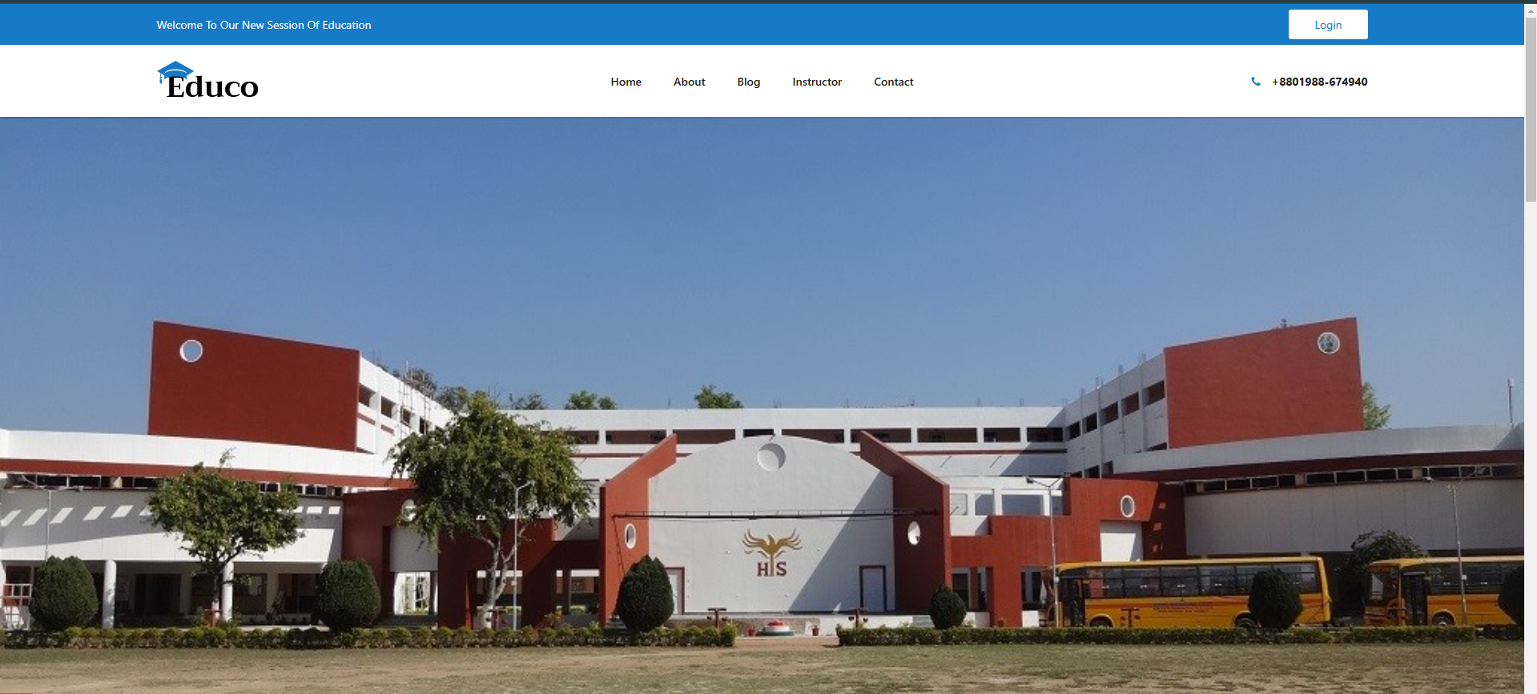
HOME PAGE

Slide 7
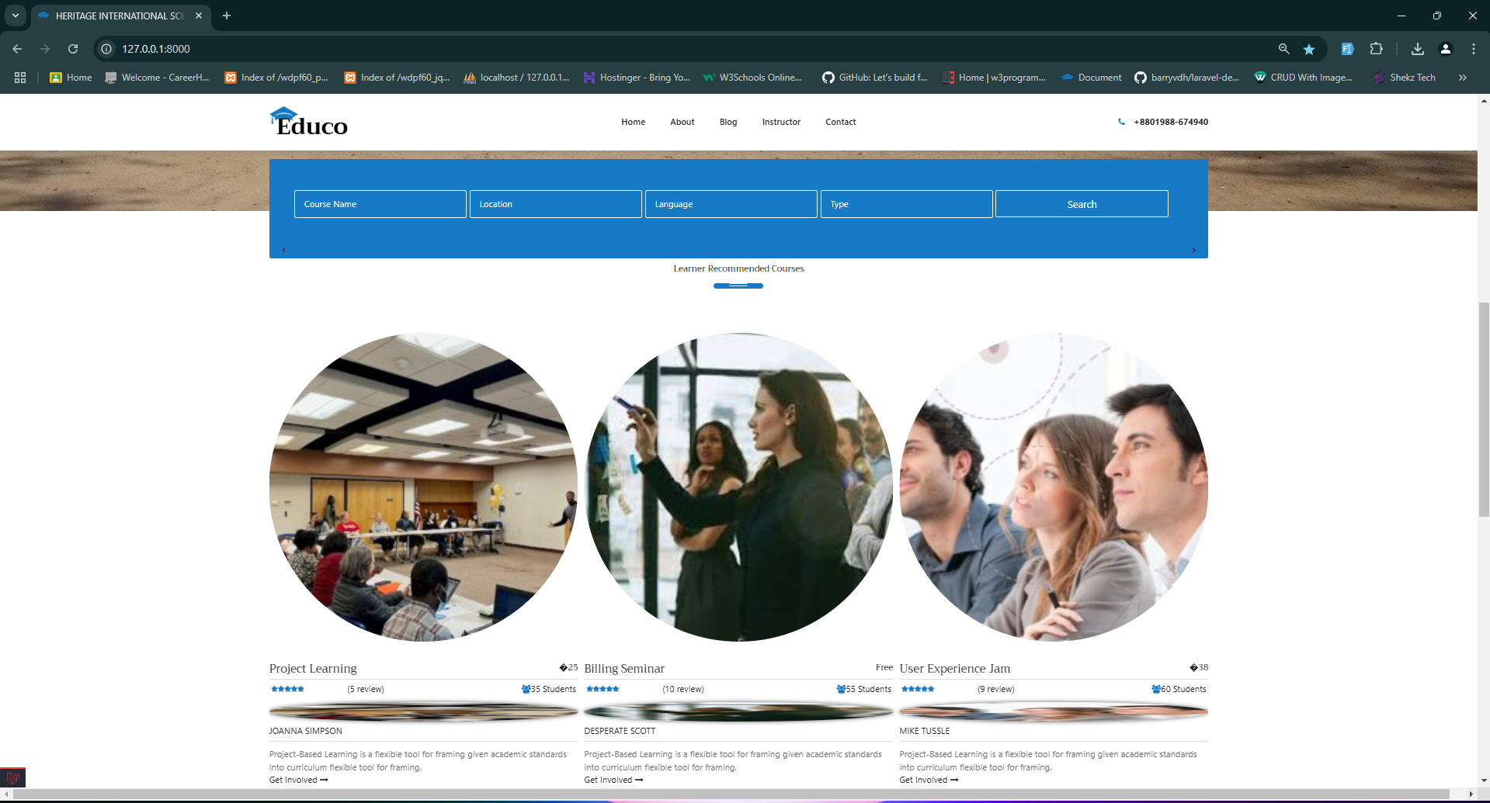
HOME PAGE

Slide 8
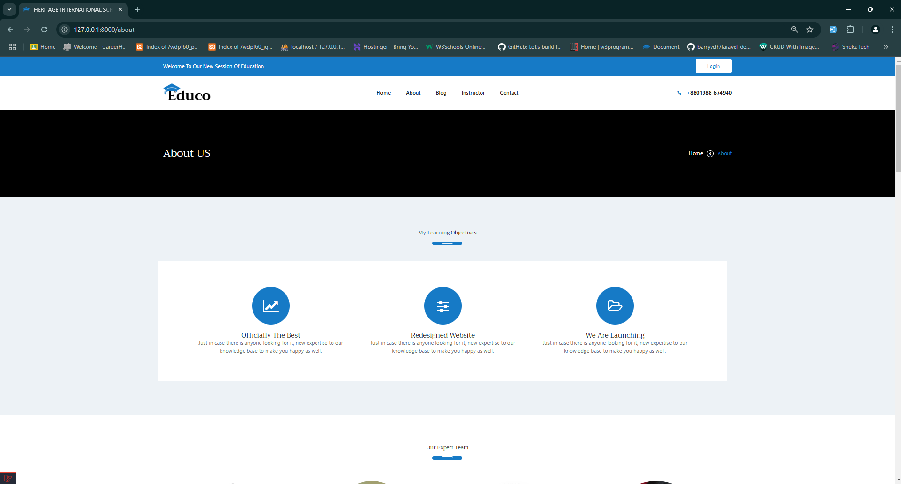
ABOUT PAGE

Slide 9
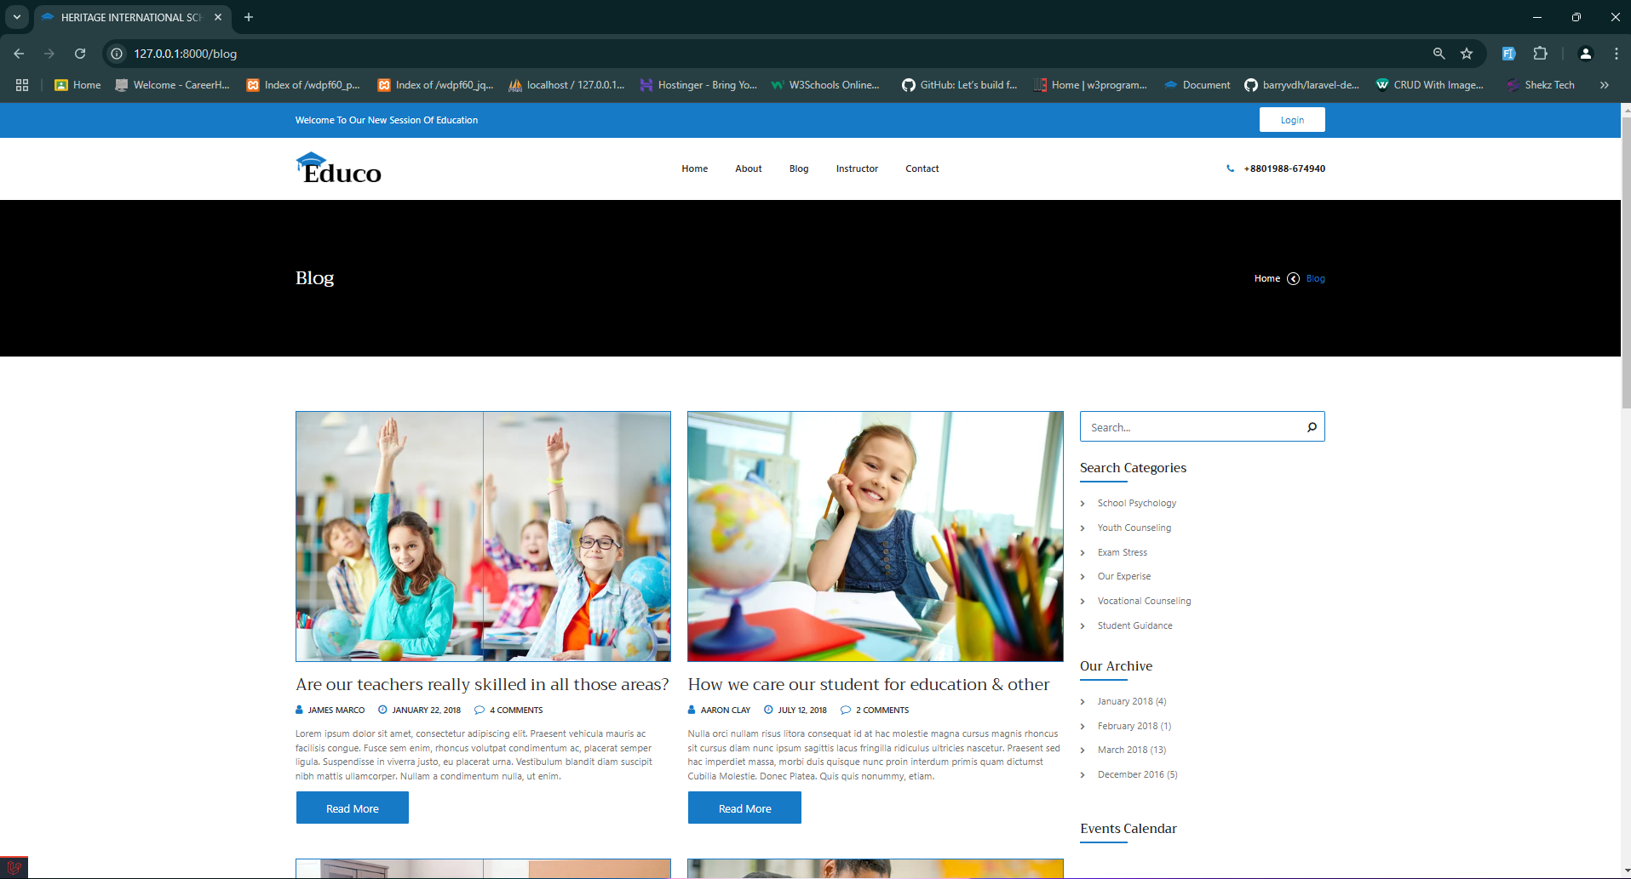
BLOG PAGE

Slide 10
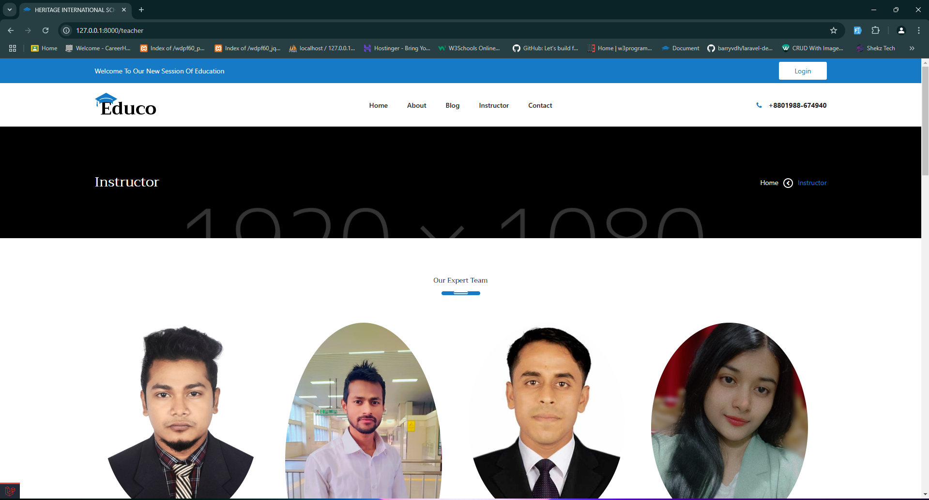
INSTRUCTOR PAGE

Slide 11
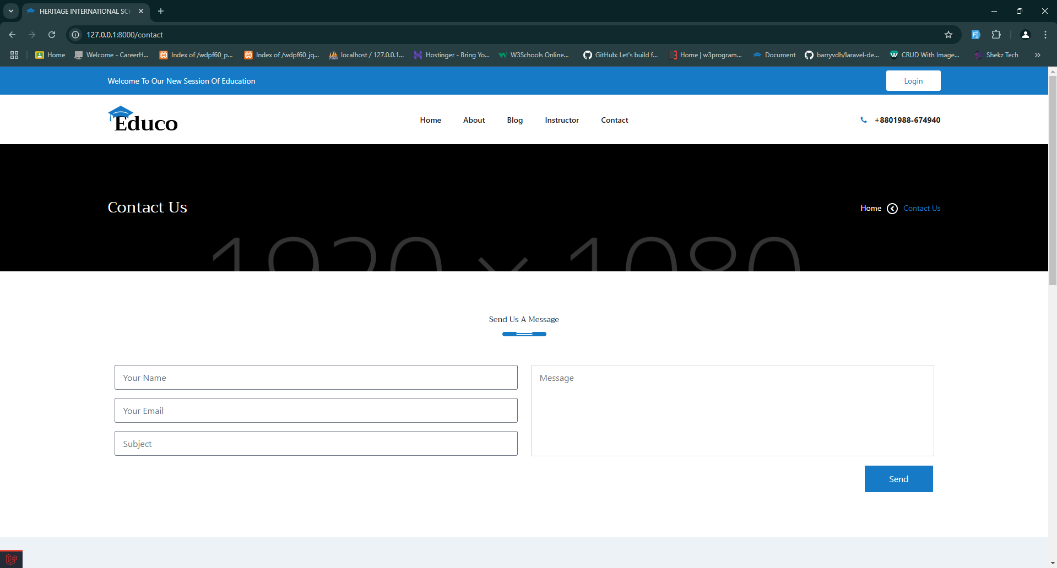
CONTACT PAGE

Slide 12
BACKEND

Slide 13
User Types
Admin
Teacher
Student
Parent

Slide 14
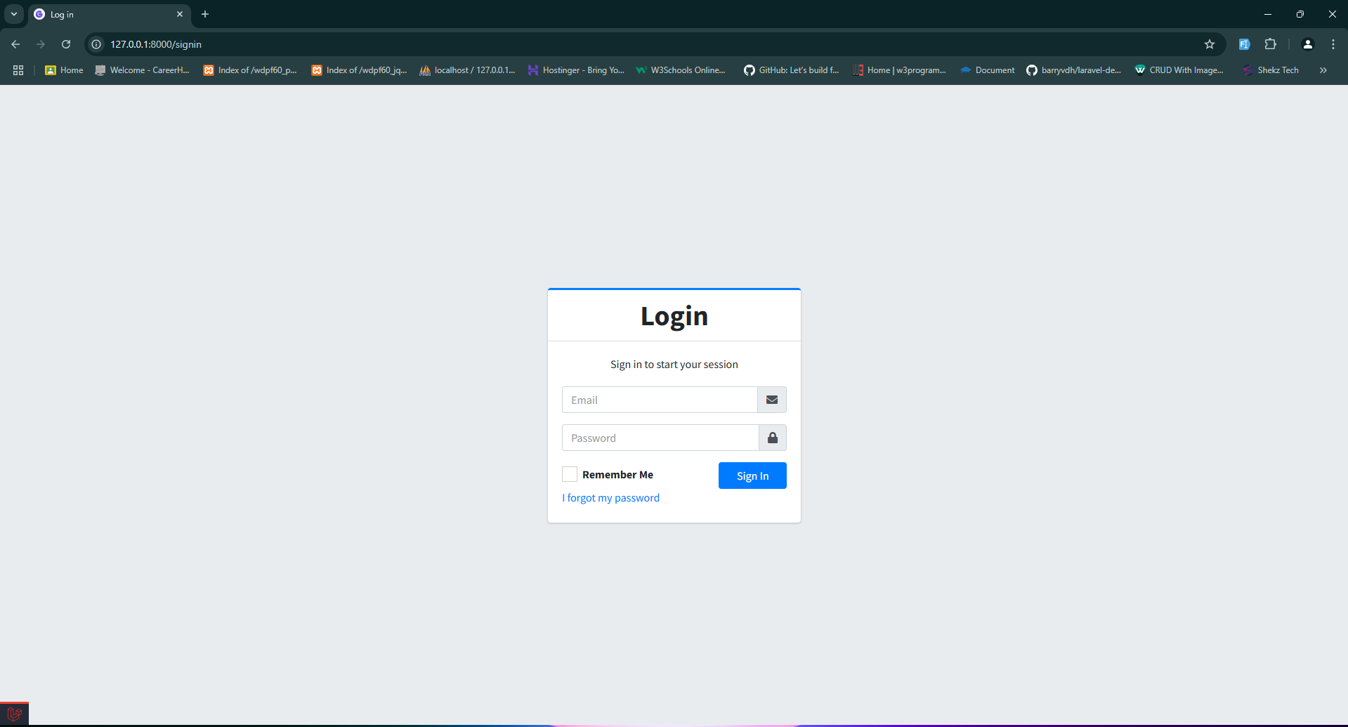
User Login Form

Slide 15
User Type
Admin

Slide 16
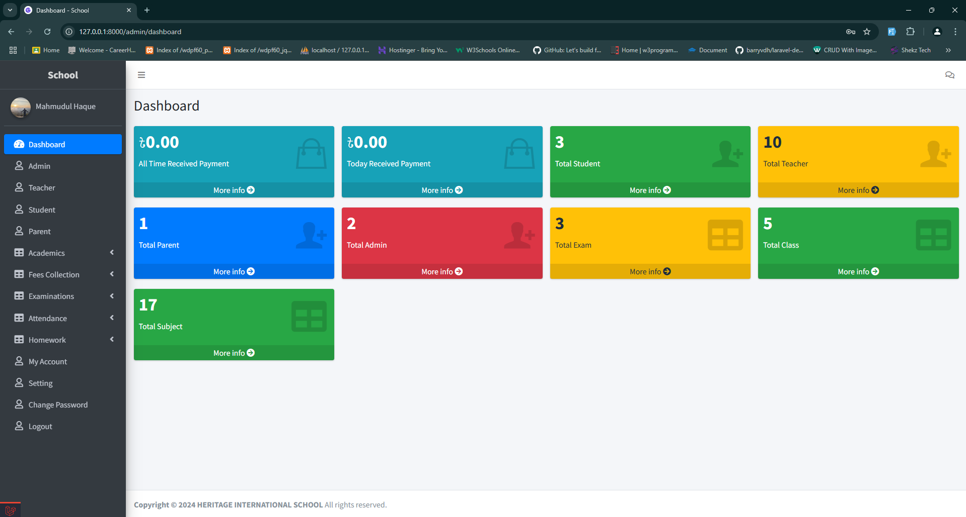
ADMIN DASHBOARD

Slide 17
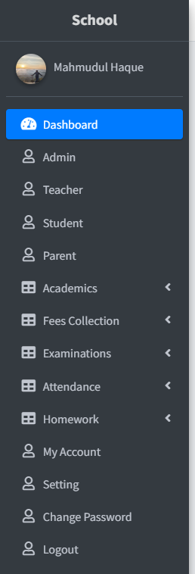
ADMIN SIDEBAR

Slide 18
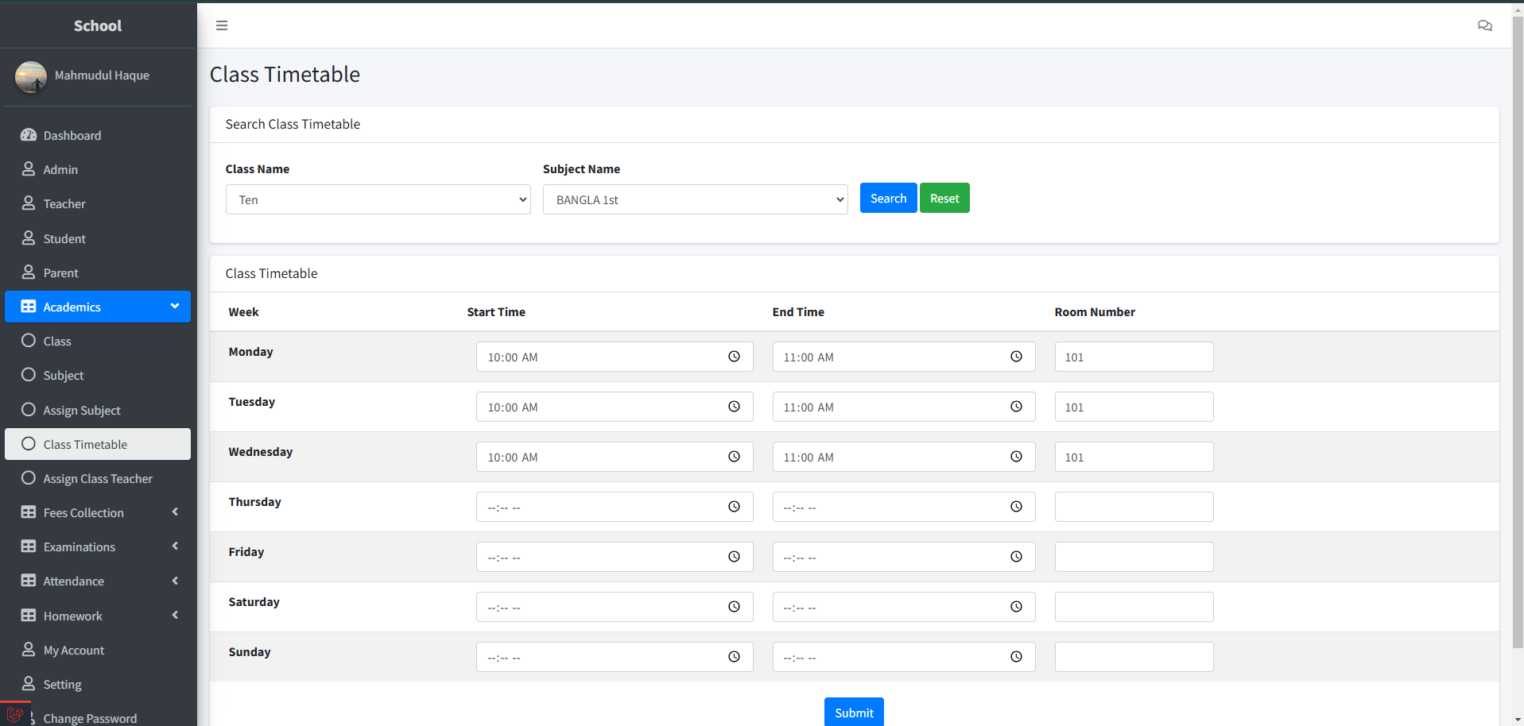
ADMIN Academics Section

Slide 19
User Type
Student

Slide 20
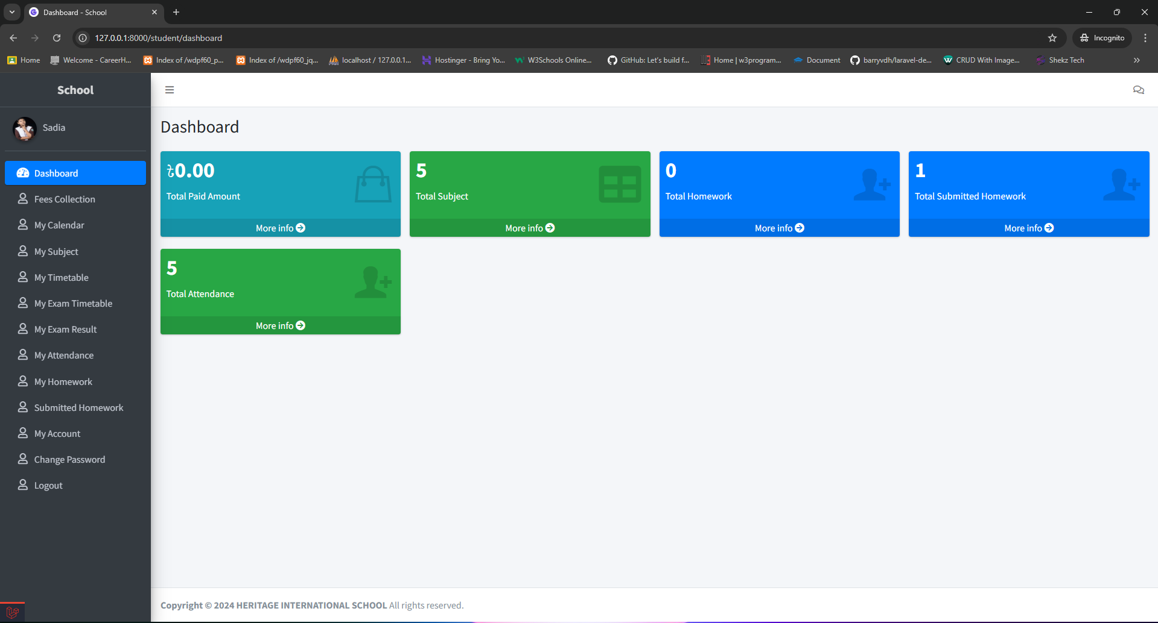
STUDENT Dashboard

Slide 21
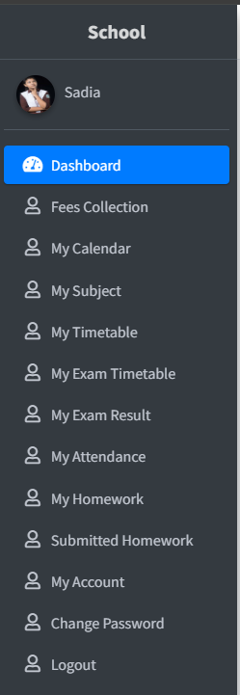
STUDENT SIDEBAR

Slide 22
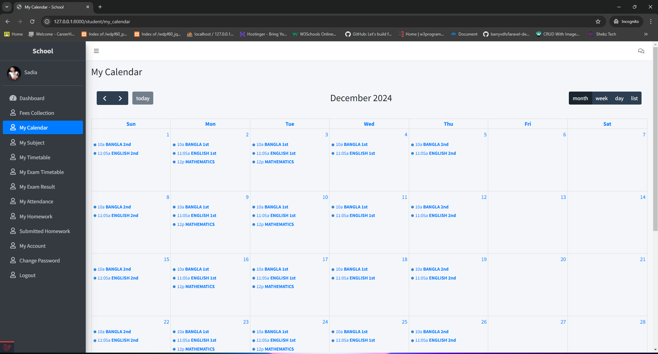
STUDENT Calendar

Slide 23
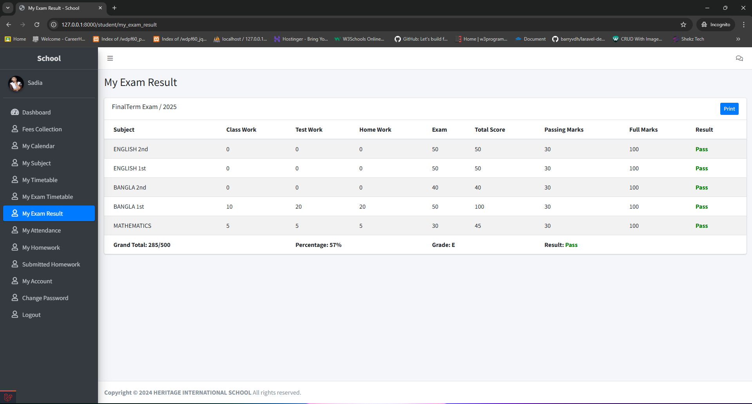
STUDENT RESULT SHEET

Slide 24
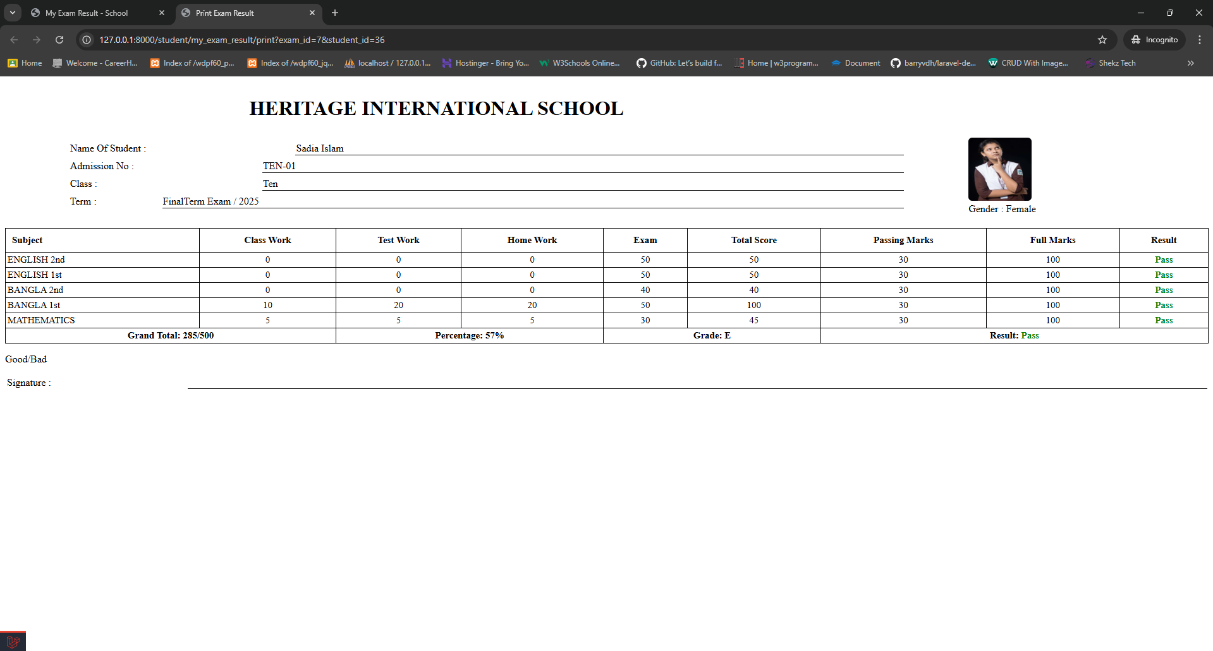
STUDENT PRINTABLE RESULT SHEET

Slide 25
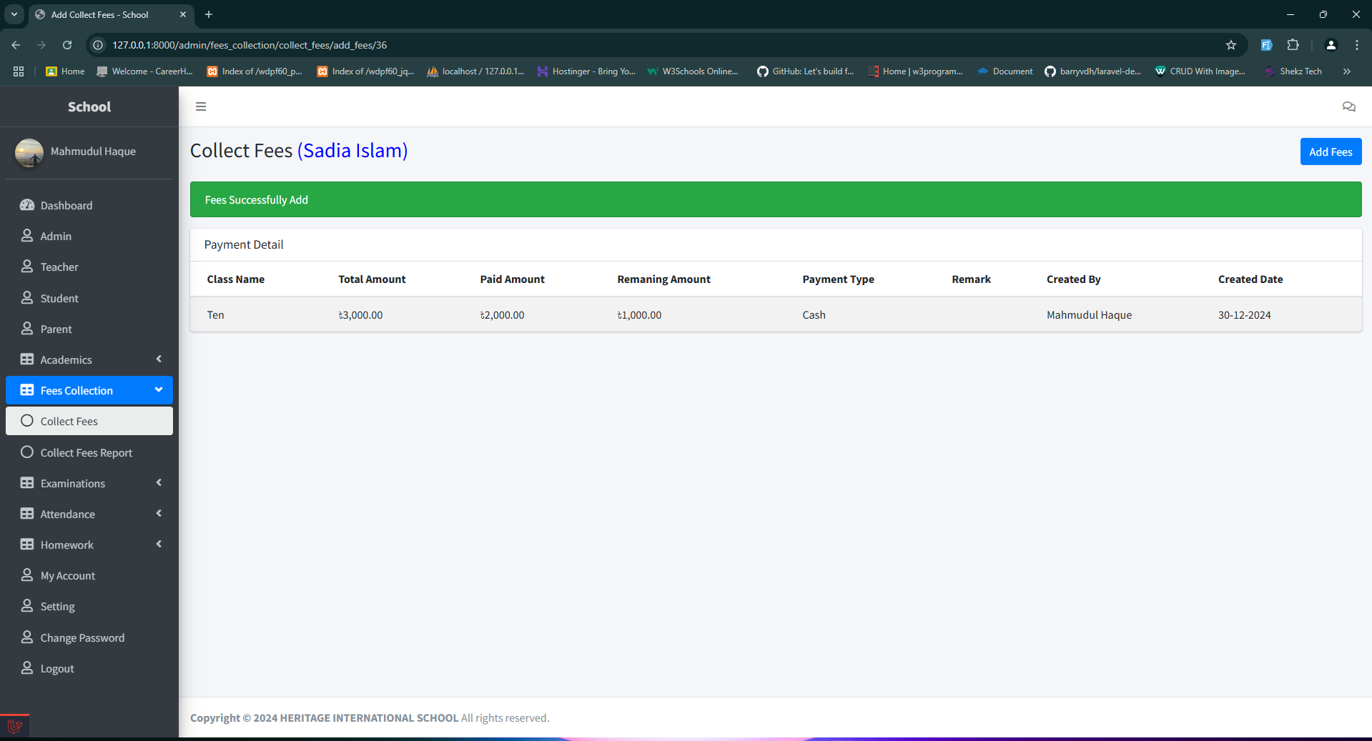
STUDENT FEES

Slide 26
User Type
Parent

Slide 27
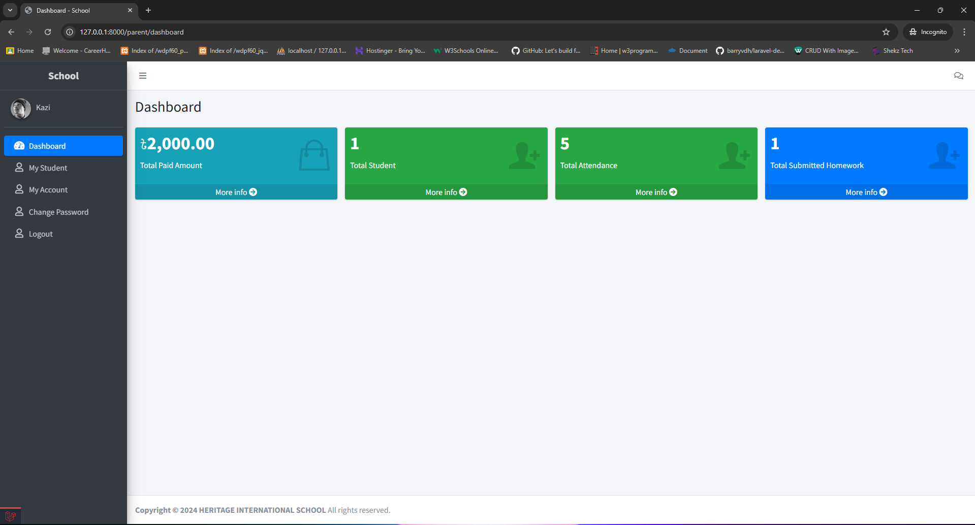
PARENT DASHBOARD

Slide 28
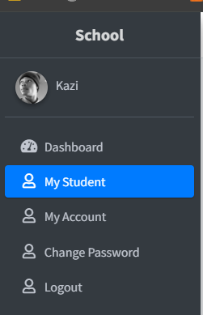
PARENT SIDEBAR

Slide 29
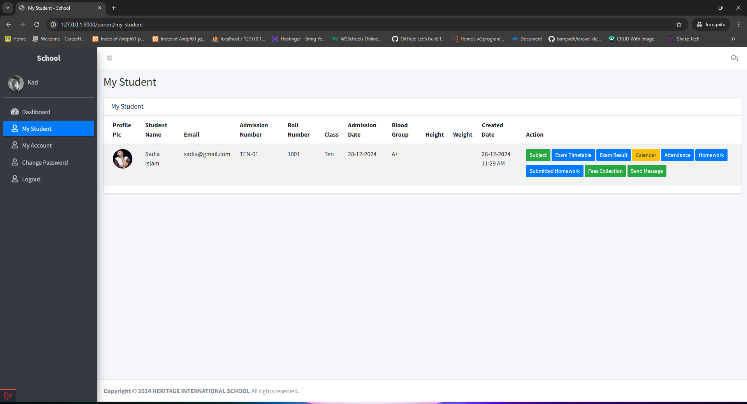
PARENT MYSTUDENT

Slide 30
THANK YOU

